Slide 1
Welcome to parent night! September 11, 2019

Slide 2
Teaming
Math-Homeroom Teacher
Language Arts-Mrs. Snoberger/Mrs. Bieber and Mrs. Spohn
Social-Mr. Feldewerd
Science-Ms. Eibensteiner

Slide 3
Math
Math Facts-- Multiplication, Division, Mixed
5 minute timing 100 problems
Goal-- 100%
Math Connects
Daily Independent Practice
Topics Covered
Numbers and Operations
Algebra
Geometry
Data Analysis

Slide 4
Reading/Language Arts
Reading Wonders Curriculum - 7 day cycle
Class novels: Hatchet (all students); other novels during literature circles
Writing: personal narrative, opinion, descriptive, biography, poetry
Spelling:
2 assignments online in Google Classroom weekly, both due on the last day of the week
Tests include using words in complete sentences, looking for correct punctuation, grammar, spelling, and word’s meaning
assigned when weeks have at least 4 days

Slide 5
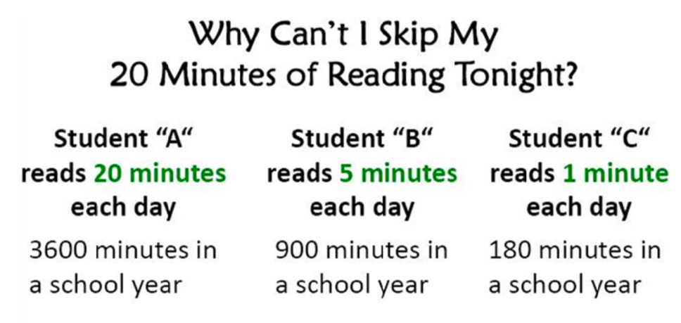
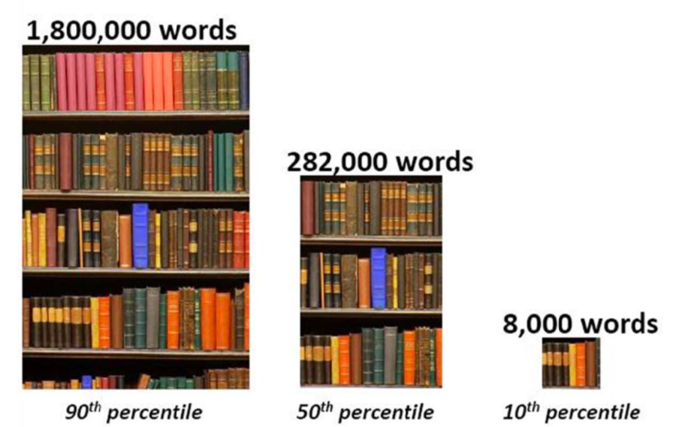
By the end of 5th grade, Student “A” will have read the equivalent of 60 whole school days. Student “B” will have read only 12 school days. Which student would you expect to have a better vocabulary? Which student would you expect to be more successful in school...and in life?
(Nagy & Herman, 1987)

Slide 6
Reading Minutes
20 minutes each day outside of school
Number of pages or chapters can be a better target than minutes

Slide 7
Independent Reading
Trimester Goal: 10 books completed at individual student level
Students need to pick from a variety of genres (realistic fiction, fantasy, informational, etc.)
Students will still be allowed to take AR tests, but it will not be how their goal is measured
Completed books will be documented in a reading log and through individual conferencing

Slide 8
Science
Scientific Method - Experiments
Interactions in Ecosystems - Types of Biomes
Changes in Ecosystems - Human Effect
Renewable/Nonrenewable Resources
Forms of Energy, Human Footprint
Earth’s Changing Surface - Layers of Earth, Earthquakes,Volcanoes,Weathering, Erosion etc...
Rocks and Minerals
Forces of Motion
Simple Machines - Lego Kits
Spheros - Coding
(note slides and review quizzes found in Google Classroom)

Slide 9
Social Studies
Review of Geography and Economics; themes are integrated in each History Unit
Ancient American Cultures
Native Americans
European Exploration
European Colonization of Americas
13 Colonies of America
Revolutionary War period
U.S. Constitution
Western Expansion
(All units have slideshows on Google classroom)

Slide 10
Curriculum-Based Measurement
FAST (Reading and Math)
Student Progress will be assessed Fall, Winter, Spring to monitor growth
MCA (Minnesota Comprehensive Assessment) in Reading, Math, Science
April-May of 2020

Slide 11
Homework/Planner
time will vary depending how time is used at school
students record daily assignments
planner is checked and should be signed daily
student responsibility

Slide 12
Technology
1 to 1 device with Chrome Books in school
Integration of technology in curriculum
Increased usage of Google Classroom
8 week Keying program using Typing Quest Jr.

Slide 13
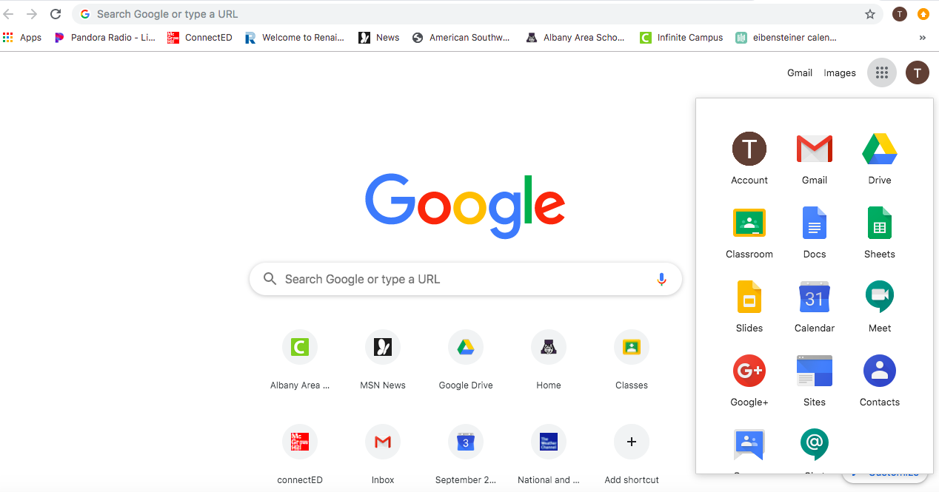
Google Classroom

Slide 14
Google Classroom

Slide 15
Google Classroom
Students will need to sign in at home with their username and password from school.
Username: lastname27@district745.org
Password: lunch number twice
Some assignments will be posted
Spelling
Slideshows of Units (Social and Science)
All Writing Projects
E-Learning Day assignments

Slide 16
E-Learning Day
Used in replace of school cancellations due to weather.
Activities posted in Google Classroom
Students will need to complete academic assignments, specialist assignments, and social/emotional activities or will be counted absent.
Students without internet access will be given alternative assignments.
Teacher Office hours are 9:00-11:00 and 1:00-3:00
Google Classroom

Slide 17
School Wide Management
PBIS
Pawsitive Pride
Be Responsible
Be Respectful
Be Safe
PAWSitive Pride
Student behavioral expectations are taught for classroom, hallway, lunchroom, playground, and bathrooms with positive reinforcements.

Slide 18
Monthly Activities
Each month students are eligible to participate in an end of month activity
Students will lose this privilege if they have a combination of 4 or more late assignments and/or do not follow our PAWSitive Pride expectations

Slide 19
Albany Elementary
Parent-Teacher Organization (PTO)
Become a member
Attend a meeting
Volunteer at an event
Support the School Walk/Fundraiser
https://www.district745.org/albany-elementary-school/parents/pto

Slide 20
Albany Area
Education Foundation
https://albanyareaef.org/
Supporting Leading-Edge Ideas and Programs
The foundation was able to award grants up to $1000 for a total of $5000
This past year ideas funded in our building:
Technology
Musical Instruments
Media Center Enhancements
Our annual fundraiser – Purple Pride by Trailside will be Thursday, November 14 at Shady’s Hometown Tavern and Event Center in Albany.

Slide 21
Albany Elementary 5th Grade Web page
http://albanyfifthgrade.weebly.com/

Slide 22
Thank you for coming and supporting your child!

